Slide 1

COAL PROJECT Quiz Game
Group members:
Syed Hamza Ahmed 21k-3344
Qamber Raza 21k-3251

Slide 2
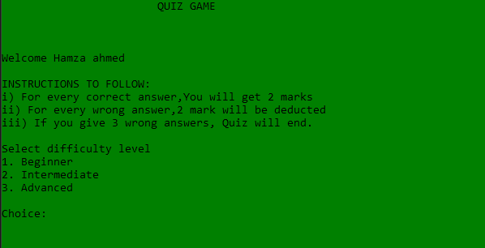
AIM
The aim was to develop a program for Quiz game with various difficulty levels to choose from using assembly language code and concepts.

Slide 3
Some Important Features:
User will be first asked to enter their name.
Then they will have 3 different levels- Easy,Medium,Hard.
After choosing one level, they will face 10 questions with 3 choices with one being the correct answer.
If the user answer 3 wrong questions, the quiz will end immediately regardless of the fact that whether 10 questions were completed or not.
The program also validates what user is entering. If the user enters an invalid character/option, he would be asked to correct it.
For each correct answer ,user gets +2 marks and -2 for each wrong answer.
In the end the score and the name of the user is printed.
If the score is good (for e.g. above 4), the program will print a different string like
“Excellent job” and if the score is low, then it would print “You need to improve”.
The user is prompted to whether he wants to play again or not.

Slide 4
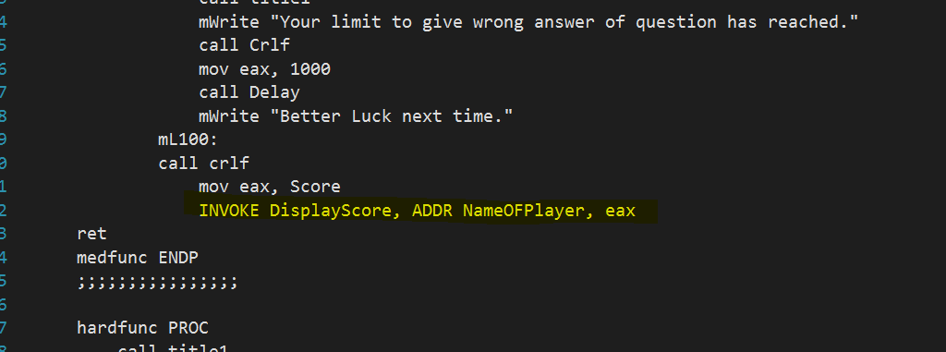
Some features we used:
Advanced Procedures:

Slide 5
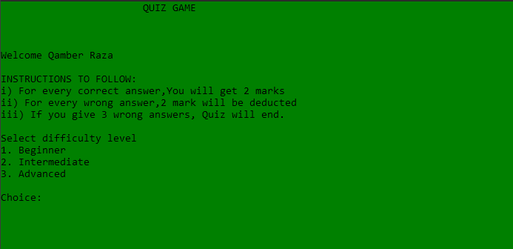
3 difficulty Levels

Slide 6
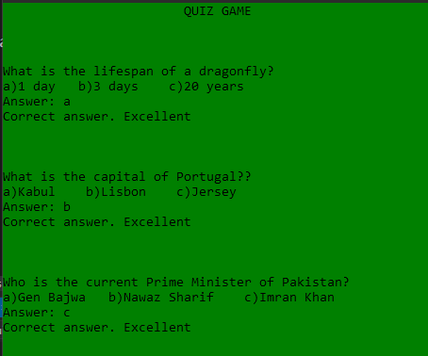
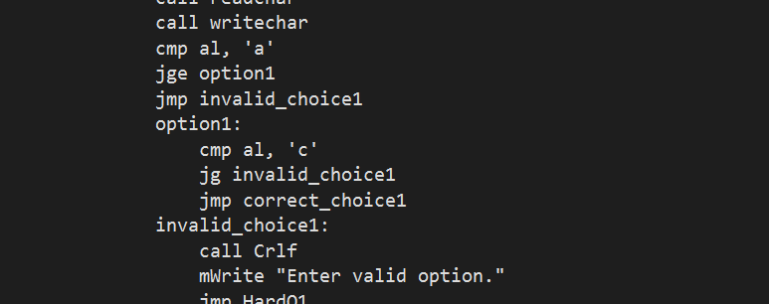
Validation:
User is given 3 options (a,b,c) to choose from. If the user enters any other character, the program will ask the use to enter again

Slide 7
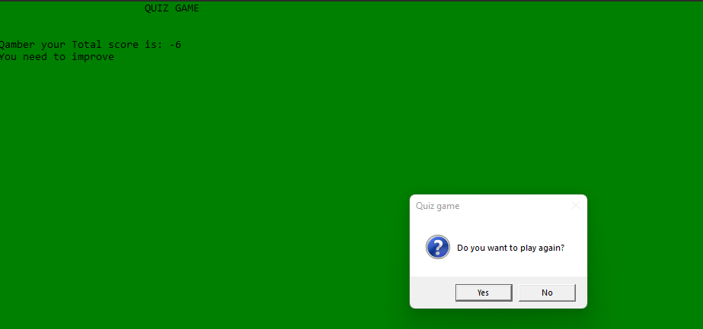
MsgBox:

Slide 8
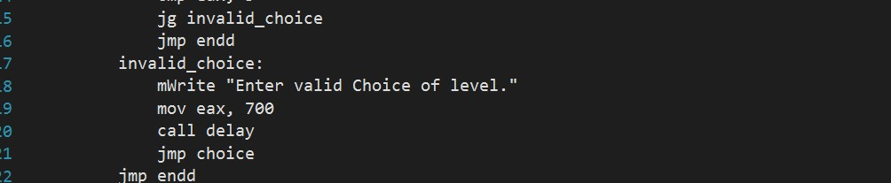
Delay Function:

Slide 9
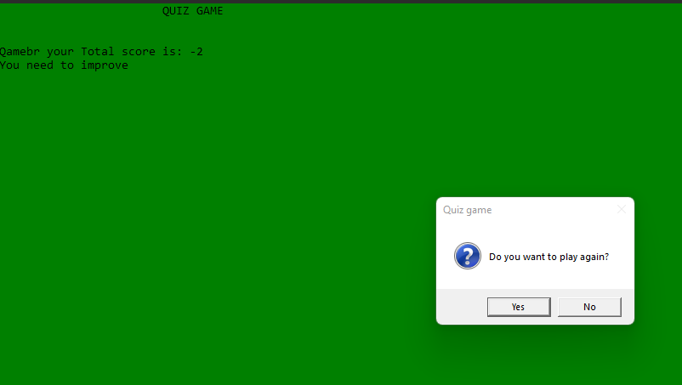
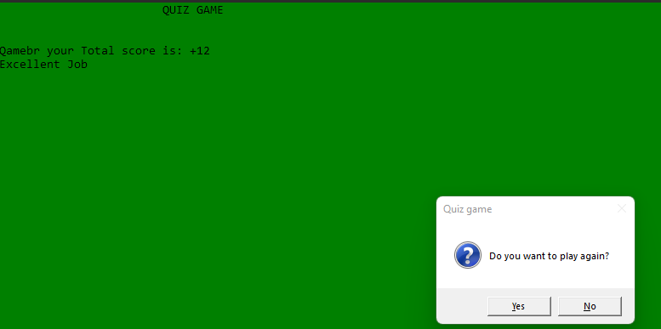
Different messsges for different scores

Slide 10
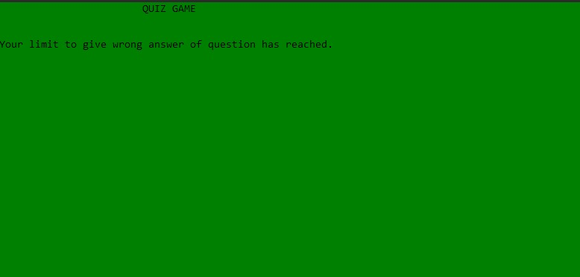
Game Ends early if you give 3 wrong answers

